Slide 1
TVD Disclosure

Slide 2
Asia Pacific 2025 Utilities Cost
Links to sources are embedded in the local currency column
Country | Water Price (per m³) |  | Electricity Cost (per kWh) |  | Minimum Wage (per hour)
 | Local Currency | USD | Local Currency | USD | Local Currency | USD
Singapore | SGD 3.24 | USD 2.38 | SGD 0.30 | USD 0.22 | SGD 10.88 | USD 8.00
Malaysia | MYR 3.51 | USD 0.79 | MYR 0.51 | USD 0.11 | MYR 8.72 | USD 1.96
Indonesia | IDR 17,500 | USD 1.07 | IDR 1,114 | USD 0.07 | IDR 2,880 | USD 0.18
Thailand | THB 31.75 | USD 0.92 | THB 4.27 | USD 0.12 | THB 50.00 | USD 1.44
Vietnam | VND 29,266 | USD 1.15 | VND 2,273 | USD 0.09 | VND 22,500 | USD 0.89
Philippines | PHP 61.04 | USD 1.04 | PHP 13.01 | USD 0.22 | PHP 86.88 | USD 1.47
Australia | AUD 3.17 | USD 1.97 | AUD 0.27 | USD 0.17 | AUD 24.95 | USD 15.47
Fiji | FJD 0.15 | USD 0.06 | FJD 0.58 | USD 0.25 | FJD 5.00 | USD 2.15
New Zealand | NZD 2.30 | USD 1.29 | NZD 0.24 | USD 0.13 | NZD 23.50 | USD 13.16
Japan | JPY 372.00 | USD 2.41 | JPY 14.00 | USD 0.09 | JPY 1,118 | USD 7.24
Korea | KRW 1,270 | USD 0.87 | KRW 113.40 | USD 0.08 | KRW 10,320 | USD 7.06

Slide 3
Machine WW Detergent – SMARTPOWER
WATER
ENERGY
PRODUCTIVITY
GREENHOUSE GASES
Value Statement
Value Statement
Value Statement
Value Statement
Liters of water saved are estimated based on a 10% reduction in dishmachine cycles due to better results.
Energy saved is estimated based on a 10% reduction in dishmachine cycles due to better results.
Productivity improvement is based on a 10% reduction in dishmachine cycles due to better results.
Greenhouse Gas reduction is based on a 10% reduction in hot water usage, and therefore a reduction in energy used to heat the water.
Disclosure Statement
Disclosure Statement
Disclosure Statement
Disclosure Statement
Water reduction is based on transition from a standard liquid detergent to a solid warewashing detergent, supporting a 10% reduction in rewashing of wares.
The reduction in rewashing is due to better cleaning performance of Smartpower Dishmachine Detergent which gets more wares clean in the first wash and therefore reduces rewashing wares.
Energy reduction is based on transition from a standard liquid detergent to a solid warewashing detergent, supporting a 10% reduction in rewashing of wares.
The reduction in rewashing is due to better cleaning performance of Smartpower Dishmachine Detergent which gets more wares clean in the first wash and therefore reduces rewashing wares.
Productivity improvement assumes employees will save 60 seconds racking and 15 seconds hand polishing per rack of wares avoided due to better results from improved operational efficiency. Assumption based on customer feedback.
Greenhouse Gas reduction is based on transition from a standard liquid detergent to a solid warewashing detergent, supporting a 10% reduction in rewashing of wares.
Energy reduction assumes a reduction in hot water due to lower usage, with hot water requiring energy to heat from 10C (50F) to 82C (180F).
The US EPA estimates Natural Gas oxidizes to 100% at 0.005306 metric tons CO₂/therm.

Slide 4
Machine WW Detergent – Solids (non-SMP)
WATER
ENERGY
PRODUCTIVITY
GREENHOUSE GASES
Value Statement
Value Statement
Value Statement
Value Statement
Liters of water saved are estimated based on an 8% reduction in dishmachine cycles due to improved operational efficiency.
Energy saved is estimated based on an 8% reduction in dishmachine cycles due to improved operational efficiency.
Productivity is estimated to improve based on an 8% reduction in dishmachine cycles due to improved operational efficiency.
Greenhouse Gas reduction is based on an 8% reduction in hot water usage, and therefore a reduction in energy used to heat the water.
Disclosure Statement
Disclosure Statement
Disclosure Statement
Disclosure Statement
Water reduction is the result of reduction in total racks run via fewer rewash, increasing dishmachine operational efficiency by 8%.
This efficiency improvement is enabled by the Ecolab-provided service (including user training, product calibration, and equipment maintenance).
Energy reduction is the result of reduction in total racks run via fewer rewash, increasing dishmachine operational efficiency by 8%.
This efficiency improvement is enabled by the Ecolab-provided service (including user training, product calibration, and equipment maintenance).
Productivity improvement is the result of reduction in total racks run via fewer rewash, increasing dishmachine operational efficiency by 8%.
This efficiency improvement is enabled by the Ecolab-provided service (including user training, product calibration, and equipment maintenance).
Assumes 60s saved per rack not run due to operational efficiency improvement, and employees will spend 15 fewer seconds hand polishing per rack of wares washed due to better ware drying with less spotting and filming. Assumption based on customer feedback.
Greenhouse Gas reduction is the result of reduction in total racks run via fewer rewash, increasing dishmachine operational efficiency by 8%.
This efficiency improvement is enabled by the Ecolab-provided service (including user training, product calibration, and equipment maintenance.
Energy reduction assumes a reduction in hot water due to lower usage, with hot water requiring energy to heat from 10C (50F) to 40C (140F).
The US EPA estimates Natural Gas oxidizes to 100% at 0.005306 metric tons CO₂/therm.

Slide 5
Machine WW Detergent – Liquids
WATER
ENERGY
PRODUCTIVITY
GREENHOUSE GASES
Value Statement
Value Statement
Value Statement
Value Statement
Liters of water saved are estimated based on a 5% reduction in dishmachine cycles due to improved operational efficiency.
Energy saved is estimated based on a 5% reduction in dishmachine cycles due to improved operational efficiency.
Productivity is estimated to improve based on a 5% reduction in dishmachine cycles due to improved operational efficiency.
Greenhouse Gas is estimated to be reduced based on an 5% reduction in hot water usage, and therefore a reduction in energy used to heat the water.
Disclosure Statement
Disclosure Statement
Disclosure Statement
Disclosure Statement
Water reduction is the result of reduction in total racks run via fewer rewash, increasing dishmachine operational efficiency by 5%.
This efficiency improvement is enabled by the Ecolab-provided service (including user training, product calibration, and equipment maintenance).
Energy reduction is the result of reduction in total racks run via fewer rewash, increasing dishmachine operational efficiency by 5%.
This efficiency improvement is enabled by the Ecolab-provided service (including user training, product calibration, and equipment maintenance).
Productivity improvement is the result of reduction in total racks run via fewer rewash, increasing dishmachine operational efficiency by 5%.
This efficiency improvement is enabled by the Ecolab-provided service (including user training, product calibration, and equipment maintenance).
Assumes 60s saved per rack not run due to operational efficiency improvement, and employees will spend 15 fewer seconds hand polishing per rack of wares washed due to better ware drying with less spotting and filming. Assumption based on customer feedback.
Greenhouse Gas reduction is the result of reduction in total racks run via fewer rewash, increasing dishmachine operational efficiency by 5%.
This efficiency improvement is enabled by the Ecolab-provided service (including user training, product calibration, and equipment maintenance.
Energy reduction assumes a reduction in hot water due to lower usage, with hot water requiring energy to heat from 10C (50F) to 40C (140F).
The US EPA estimates Natural Gas oxidizes to 100% at 0.005306 metric tons CO₂/therm.

Slide 6
Manual WW Detergent – SMARTPOWER
WATER
ENERGY
PRODUCTIVITY
GREENHOUSE GASES
Value Statement
Value Statement
NOT APPLICABLE
Value Statement
Liters of water saved are estimated based on a reduction in sinks required.
Energy saved is estimated based on a reduction in sinks required.
Greenhouse Gas reduction is based on a reduction in sinks required.
Disclosure Statement
Disclosure Statement
Disclosure Statement
Water reduction is based on a 25% reduction in sinks required to wash an equivalent amount of ware in the sink due to a more concentrated product.
Energy reduction is based on a 25% reduction in sinks required to wash an equivalent amount of ware in the sink due to a more concentrated product.
Greenhouse Gas reduction is based on a 25% reduction in sinks required to wash an equivalent amount of ware in the sink due to a more concentrated product.
The US EPA estimates Natural Gas oxidizes to 100% at 0.005306 metric tons CO2/therm.

Slide 7
Sanitizing Wash ‘N Walk / No-Rinse Floor Cleaners
WATER
ENERGY
PRODUCTIVITY
GREENHOUSE GASES
Value Statement
Value Statement
Value Statement
Value Statement
Liters of water saved are estimated based on the elimination of the rinsing step.
Energy saved is estimated based on the elimination of the rinsing step and the use of unheated water.
Productivity is estimated to improve based on the elimination of the rinsing step.
Greenhouse Gas is estimated to be reduced based on the elimination of the rinsing step and the use of unheated water.
Disclosure Statement
Disclosure Statement
Disclosure Statement
Disclosure Statement
Water reduction is based on the elimination of the floor rinsing step following recommended use instructions.
From Ecolab testing, 29.1L of floor cleaner are used for floor cleaning a standard kitchen floor, and 37.9L of water are used for rinsing.
Energy reduction is estimated based on the elimination of the rinsing step and the use of unheated water.
Based on Ecolab testing, 29.1L of floor cleaner are used for floor cleaning a standard kitchen floor, and 37.9L of hot (60C / 140F) water are used for rinsing.
Productivity improvement is based on the elimination of the floor rinsing step following recommended use instructions.
Based on Ecolab testing, 29.1L of floor cleaner is used when cleaning a standard kitchen floor, and rinse time is 1200 seconds.
Greenhouse Gas reduction is estimated based on the elimination of the rinsing step and the use of unheated water.
Based on Ecolab testing 29.1L of floor cleaner are used for floor cleaning a standard kitchen floor, and 37.9L of hot (60C / 140F) water are used for rinsing.
The US EPA estimates Natural Gas oxidizes to 100% at 0.005306 metric tons CO₂/therm.

Slide 8
Pre-Soak Products
The pre-soak soaking tub is assumed to be 7.57L with a presoaking capacity of 5 racks of flatware soaked per tub.
WATER
ENERGY
PRODUCTIVITY
GREENHOUSE GASES
Value Statement
Value Statement
Value Statement
Value Statement
Liters of water saved are estimated based on an improvement in one-pass washing.
Energy saved is estimated based on an improvement in one-pass washing.
Productivity is estimated to improve based on a reduction in hand polishing time as well as a reduction in racks run.
Greenhouse Gas is estimated to be reduced based on an improvement in one-pass washing.
Disclosure Statement
Disclosure Statement
Disclosure Statement
Disclosure Statement
Water reduction is based on a reduction in rewash of wares through the dishmachine due to more effective cleaning.
Based on 2009 Ecolab lab testing, using Smartpower Pre-Soak to pre-soak gets flatware clean in 2 dish machine cycles verses 4 cycles when using Pantastic to pre-soak.
Hot water usage per rack of dishes run is on average 3.79L with a temperature of 60C (140F) from a 10C (50F) water input.
Energy reduction is estimated based on a reduction in rewash of wares through the dishmachine due to more effective cleaning.
Based on 2009 Ecolab lab testing, using Smartpower Pre-Soak to pre-soak gets flatware clean in 2 dish machine cycles verses 4 cycles when using Pantastic to pre-soak.
Hot water usage per rack of dishes run is on average 3.79L with a temperature of 60C (140F) from a 10C (50F) water input.
Productivity improvement is based on a reduction in rewash of wares through the dishmachine due to more effective cleaning.
Based on 2009 Ecolab lab testing, using Smartpower Pre-Soak to pre-soak gets flatware clean in 2 dish machine cycles verses 4 cycles when using Pantastic to pre-soak.
Eliminated rack re-processing and polishing estimated at 15 seconds per rack.
Greenhouse Gas reduction is estimated based on a reduction in rewash of wares through the dishmachine due to more effective cleaning.
Based on 2009 Ecolab lab testing, using Smartpower Pre-Soak to pre-soak gets flatware clean in 2 dish machine cycles verses 4 cycles when using Pantastic to pre-soak.
Hot water usage per rack of dishes run is on average 3.79L with a temperature of 60C (140F) from a 10C (50F) water input.
The US EPA estimates Natural Gas oxidizes to 100% at 0.005306 metric tons CO₂/therm.

Slide 9
Laundry – Aquanomics
WATER
ENERGY
PRODUCTIVITY
GREENHOUSE GASES
Value Statement
Value Statement
Value Statement
Value Statement
Liters of water saved are estimated based on a reduction in reclaim as well as a switch to SmartWash formulas.
Energy saved is estimated based on a reduction in reclaim as well as a switch to SmartWash formulas.
Productivity is estimated to improve based on a reduction in reclaim.
Greenhouse Gas is estimated to be reduced based on a reduction in reclaim as well as a switch to SmartWash formulas.
Disclosure Statement
Disclosure Statement
Disclosure Statement
Disclosure Statement
Water reduction is based on transition from using traditional wash formulas to Aquanomics Ecolab SmartWash formulas.
This assumes a reduction in water usage from Ecolab Smartwash formulas and a 2% reduction in total loads run due to better stain removal and fewer reclaim loads. The Ecolab Smartwash formulas use approximately 40% less water than a traditional laundry cycle (503 L vs 810 L based on Ecolab recommended wash cycles).
Reclaim reduction is calculated based on an Ecolab study which showed AQUANOMIC 2.0 LOW TEMP LAUNDRY DETERGENT provided a 3% overall reclaim rate vs. an industry average of 5%
Energy reduction is estimated based on transition from using traditional wash formulas to Aquanomics Ecolab SmartWash formulas.
This assumes a reduction in energy usage from Ecolab Smartwash formulas and a 2% reduction in total loads run due to better stain removal and fewer reclaim loads. The Ecolab Smartwash formulas use approximately 50% less energy than a traditional laundry cycle (0.43 therms vs 0.97 therms based on Ecolab recommended wash cycles).
Reclaim reduction is calculated based on an Ecolab study which showed AQUANOMIC 2.0 LOW TEMP LAUNDRY DETERGENT provided a 3% overall reclaim rate vs. an industry average of 5%
Productivity improvement is due to an estimated 2% reduction in total loads run due to better stain removal and fewer reclaim loads.
Reclaim reduction is calculated based on an Ecolab study which showed AQUANOMIC 2.0 LOW TEMP LAUNDRY DETERGENT provided a 3% overall reclaim rate vs. an industry average of 5%.
Each laundry cycle takes an estimated 1.3 hours of run time based on Ecolab recommended wash cycles.
Greenhouse Gas reduction is estimated based on transition from using traditional wash formulas to Aquanomics Ecolab SmartWash formulas.
This assumes a reduction in energy usage from Ecolab Smartwash formulas and a 2% reduction in total loads run due to better stain removal and fewer reclaim loads. The Ecolab Smartwash formulas use approximately 50% less energy than a traditional laundry cycle (0.43 therms vs 0.97 therms based on Ecolab recommended wash cycles).
Reclaim reduction is calculated based on an Ecolab study which showed AQUANOMIC 2.0 LOW TEMP LAUNDRY DETERGENT provided a 3% overall reclaim rate vs. an industry average of 5%

Slide 10
Laundry – Standard
WATER
ENERGY
PRODUCTIVITY
GREENHOUSE GASES
Value Statement
Value Statement
Value Statement
Value Statement
Liters of water saved are estimated based on a reduction in reclaim.
Energy saved is estimated based on a reduction in reclaim.
Productivity is estimated to improve based on a reduction in reclaim.
Greenhouse Gas output is reduced based on a reduction in reclaim.
Disclosure Statement
Disclosure Statement
Disclosure Statement
Disclosure Statement
Water reduction is the result of reduction in total loads run via better stain removal and fewer reclaim loads, increasing laundry operational efficiency by 2%.
This efficiency improvement is enabled by the Ecolab-provided service (including user training, product calibration, wash formula selection, and equipment maintenance).
Each laundry cycle uses approximately 810L of water based on Ecolab recommended wash cycles.
Energy reduction is the result of reduction in total loads run via better stain removal and fewer reclaim loads, increasing laundry operational efficiency by 2%.
This efficiency improvement is enabled by the Ecolab-provided service (including user training, product calibration, wash formula selection, and equipment maintenance.
Each laundry cycle uses approximately 0.97 therms of energy.
Productivity improvement is the result of reduction in total loads run via better stain removal and fewer reclaim loads, increasing laundry operational efficiency by 2%.
This efficiency improvement is enabled by the Ecolab-provided service (including user training, product calibration, wash formula selection, and equipment maintenance.
Each laundry cycle takes an estimated 1.3 hours of run time based on Ecolab recommended wash cycles.
Greenhouse Gas reduction is the result of reduction in total loads run via better stain removal and fewer reclaim loads, increasing laundry operational efficiency by 2%.
This efficiency improvement is enabled by the Ecolab-provided service (including user training, product calibration, wash formula selection, and equipment maintenance).
The US EPA estimates Natural Gas oxidizes to 100% at 0.005306 metric tons CO₂/therm.
Each laundry cycle uses approximately 0.97 therms of energy.

Slide 11
Laundry – Low Temperature (Oxyguard)
WATER
ENERGY
PRODUCTIVITY
GREENHOUSE GASES
Value Statement
Value Statement
Value Statement
Value Statement
Liters of water saved are estimated based on a reduction in reclaim.
Energy saved is estimated based on a reduction in temperature used in the laundry cycles.
Productivity is estimated to improve based on a reduction in reclaim.
Greenhouse Gas output is reduced based on a reduction in temperature used in the laundry cycles.
Disclosure Statement
Disclosure Statement
Disclosure Statement
Disclosure Statement
Water reduction is the result of reduction in total loads run via better stain removal and fewer reclaim loads, increasing laundry operational efficiency by 2%.
This efficiency improvement is enabled by the Ecolab-provided service (including user training, product calibration, wash formula selection, and equipment maintenance).
Each laundry cycle uses approximately 810L of water based on Ecolab recommended wash cycles.
Energy reduction is the result of transitioning from using a traditional high temperature wash to Oxyguard Detergent using Low Temperature wash formulas.
The estimated energy savings are based on lowering the hot water temperature from 60C to 40C, which accounts for approximately 52% of the water used each laundry load.
A machine water efficiency of 17.9 L per kg dry linen.
Productivity improvement is the result of reduction in total loads run via better stain removal and fewer reclaim loads, increasing laundry operational efficiency by 2%.
This efficiency improvement is enabled by the Ecolab-provided service (including user training, product calibration, wash formula selection, and equipment maintenance.
Each laundry cycle takes an estimated 1.3 hours of run time based on Ecolab recommended wash cycles.
Greenhouse Gas reduction is the result of transitioning from using a traditional high temperature wash to Oxyguard Detergent using Low Temperature wash formulas.
This assumes a reduction in energy usage by reducing the hot water temperature from 60C to 40C, which accounts for an estimated 52% of the water used each load.
The US EPA estimates Natural Gas oxidizes to 100% at 0.005306 metric tons CO₂/therm.

Slide 12
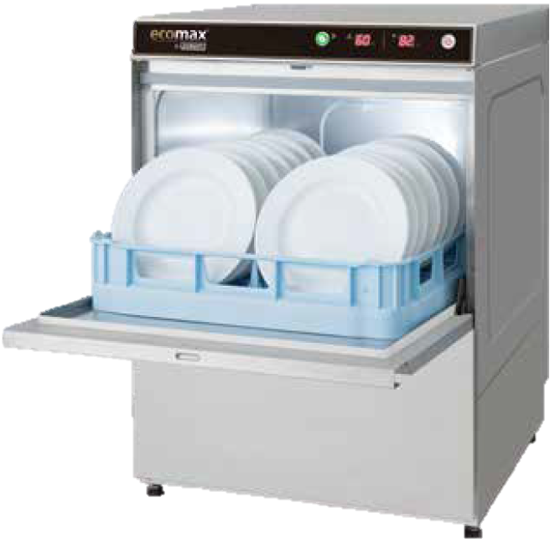
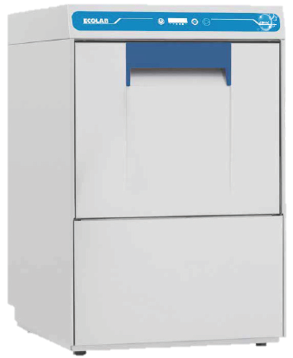
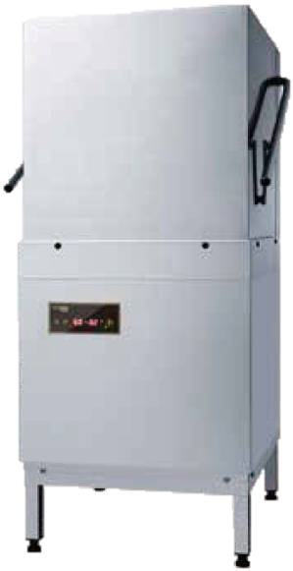
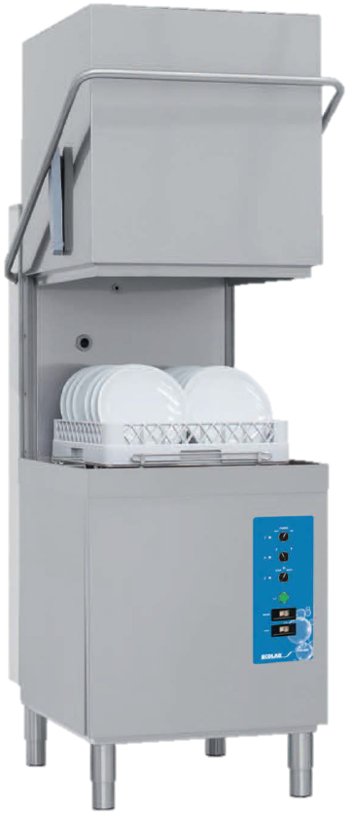
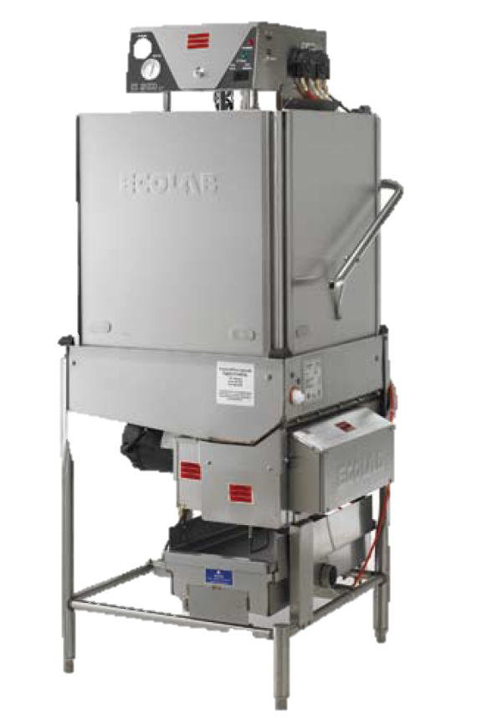
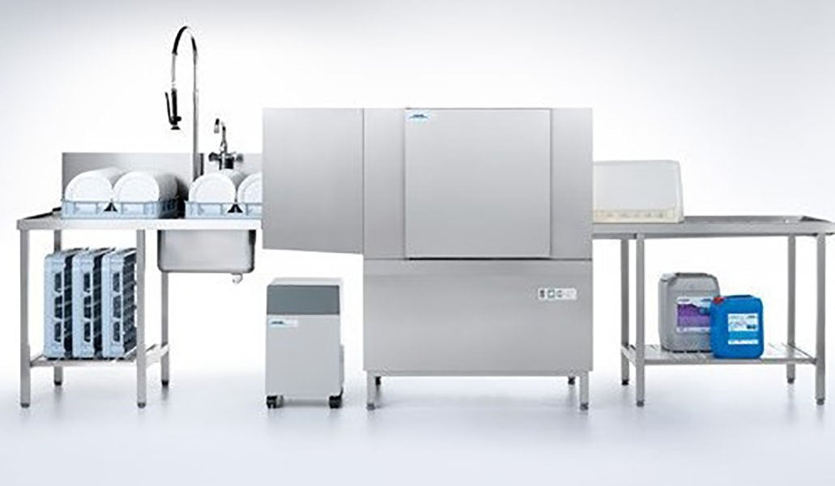
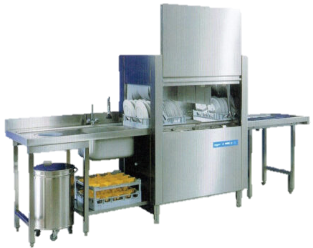
Comparison Chart (SEA Only)
Category | Competitor Machine | Ecolab CSH Model | Ecolab ES Model
Undercounter | Hobart Ecomax F500 | CSH40
Hood | Hobart Ecomax H600 | CSH60 | ES2000HT
Single-Tank Conveyor | Winterhalter STR 208 | CSH200 | ES4400

Slide 13
Machine Specifications & Assumptions
Type | Machine Name | Cycle Time (min) | Water Usage (L / rack) | Booster Heating (kW) | Tank Heating (kW) | Wash Pump (kW) | Rinse Booster Pump (kW) | No. of racks per hour | No. of racks washed per year | Washing Energy Rate (kWh / rack)
Undercounter | CSH40 | 1.50 | 1.80 | 6.00 | 1.40 | 0.50 | 0.20 | 40 | 109,500 | 0.20
 | Hobart Ecomax F500 | 1.50 | 2.30 | 7.50 | 2.00 | 0.38 | - | 40 | 109,500 | 0.25
Hood | CSH60 | 1.00 | 2.30 | 12.00 | 2.50 | 0.70 | 0.20 | 60 | 164,250 | 0.26
 | Hobart Ecomax H600 | 1.20 | 2.50 | 12.00 | 2.00 | 0.60 | - | 50 | 136,875 | 0.29
Conveyor | CSH200 | 0.30 | 1.50 | 13.00 | 12.00 | 1.50 | - | 200 | 547,500 | 0.13
 | Winterhalter STR 208 | 0.50 | 2.70 | 30.30 | 4.50 | 1.70 | 0.20 | 130 | 355,875 | 0.28
All raw numbers (non-blue headers) are taken from the dishmachine sell sheets.
Calculating the no. of racks washed per year
No. of racks washed per year = No. of racks per hour * Operation hours per meal service * No. of meal services per day * 365 days a year
During computation, the competitor’s no. of racks washed per year was used.
(Assuming 2.5 hours per service)
(Assuming 3 per day)
Calculating the washing energy rate
Washing energy rate (kWh / rack) = [(Booster heating + Tank heating + Wash pump + Rinse booster pump) * 1 hour] / No. of racks per hour
kW
h
rack

